Slide 1
Week 8 – Power!
November 16, 2012

Slide 2
Goals
t-test review
Power!
Questions?

Slide 3
Types of t-tests
Single sample t-test
  (How likely is it that your sample came from your null population?)
Two sample t-test
  (How likely is it that your two samples came from the same population?)
  Pooled variance
Matched pairs t-test
  (How likely is it that the difference between pre-and post scores is zero?)

Slide 4
Type I and Type II errors
 | H₀ True | H₀ False
Reject H₀ | Type I error α | Correct! Power: 1-β
Retain H₀ | Correct! Confidence: 1-α | Type II error β

Slide 5
Type I and Type II errors
 | H₀ True | H₀ False
Reject H₀ | Type I error α | Correct! Power: 1-β
Retain H₀ | Correct! Confidence: 1-α | Type II error β

Slide 6
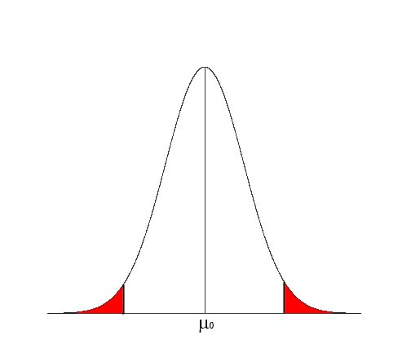
Type I errors
We determine our chance of making Type I errors when we set α—the percent of observations in the red area
If we calculate a t-statistic in the red area and the null hypothesis is true, we will mistakenly reject H₀
t_{α}

Slide 7
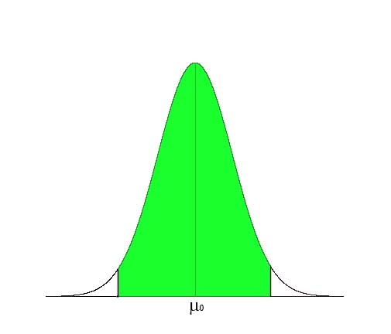
1-α
If H₀ is true, 1- α % of the sample means we draw will not lead us to mistakenly reject the null hypothesis

Slide 8
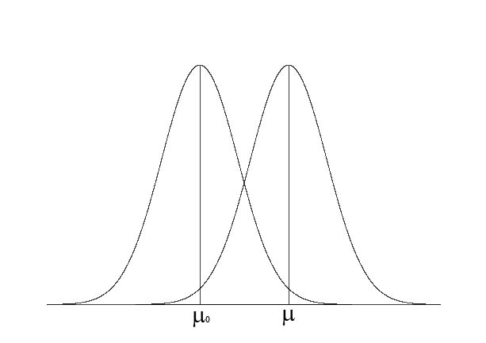
What if H₀ is false?
If H₀ is false, then our sample mean is drawn from a population with a true mean that is different than μ₀

Slide 9
Type I and Type II errors
 | H₀ True | H₀ False
Reject H₀ | Type I error α | Correct! Power: 1-β
Retain H₀ | Correct! Confidence: 1-α | Type II error β

Slide 10
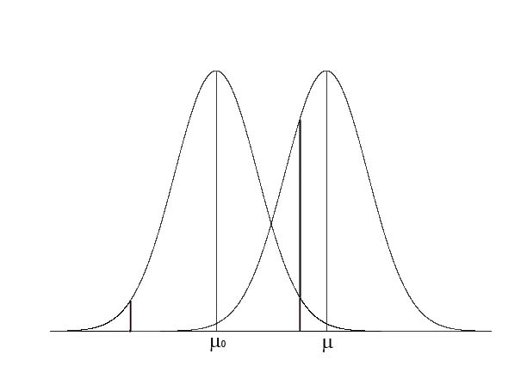
What if H₀ is false?
Comparisons are still made using a critical t-value determined relative to μ₀
t_{α}

Slide 11
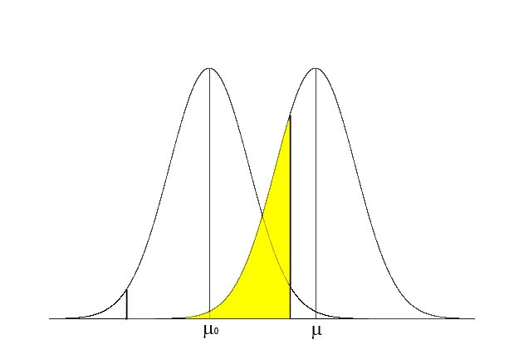
Type II errors
Type II errors are when we mistakenly retain the null hypothesis when it is false
This happens when we calculate a t-statistic in the yellow area
The proportion of observations in the yellow area is β

Slide 12
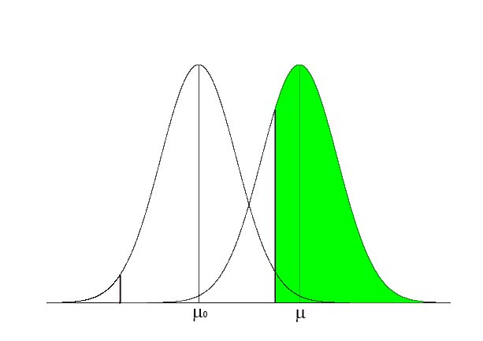
Power: 1-β
The likelihood we will correctly reject the null hypothesis is 1-β—the proportion of possible sample means in the region of rejection for the null hypothesis

Slide 13
What determines power?
First, we need a specific alternative mean. The standardized difference between our null hypothesis and this mean is the effect size, d. Can also think of this as the desired minimum detectable difference.
d

Slide 14
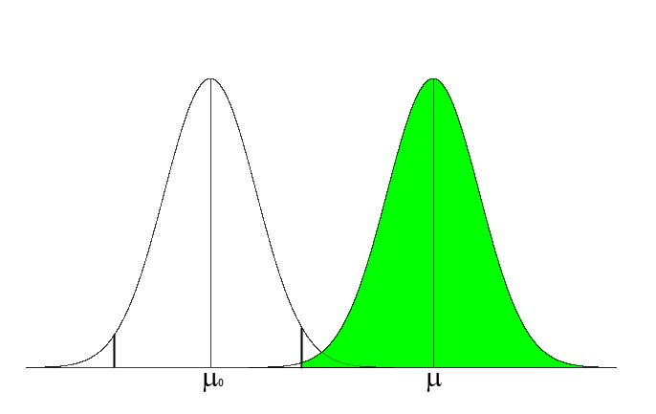
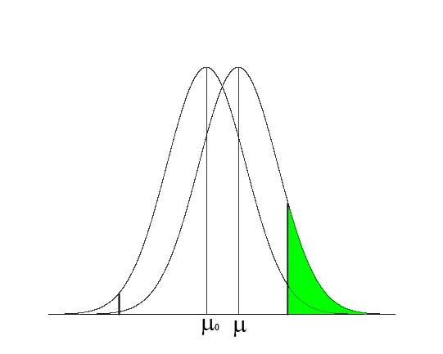
The relationship between d and power
We have more power to detect large effects (big d) than small ones (little d).
Big d
Small d

Slide 15
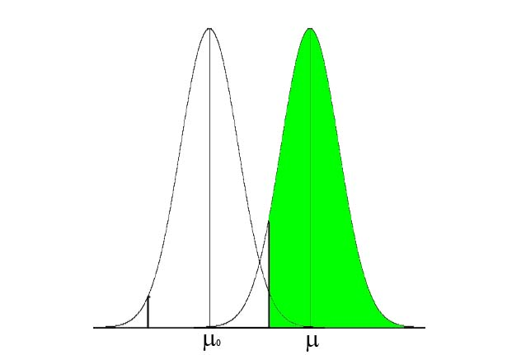
What determines power?
Because it affects the shape of the sampling distributions, N also affects power—higher N means more power
Lower N
Higher N

Slide 16
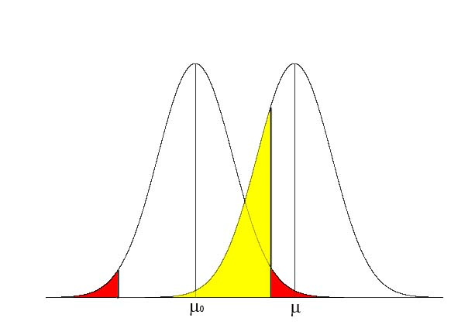
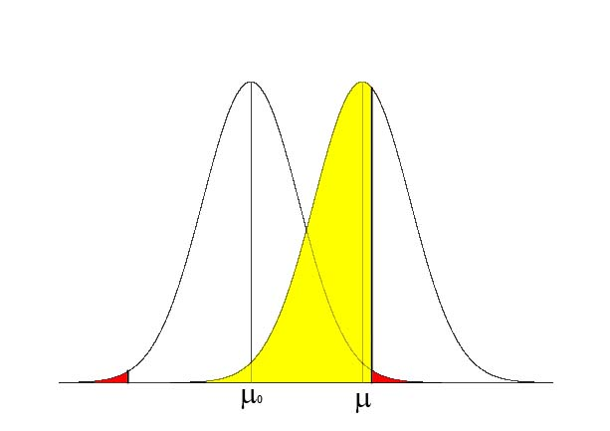
What determines power?
Because power is represented by the area of the sampling distribution of the true (or alternative) mean that is in the region of rejection of the null hypothesis, α also affects power
Note these graphs give α and β rather than 1-β (power), which is what we’ve seen in previous graphs
Higher α
Lower α

Slide 17
What determines power?
Power is determined by d, N, and α
d and N are both captured, in general by
For single sample t-tests
You can then look up the power of a given δ associated with different levels of α (in Table D in back of book)

Slide 18
Problem
You develop a new measure of social efficacy for adolescent
girls, with 24 items on a 3-point scale. The scale seems to
have μ = 18, and σ = 16.
You are asked to evaluate a new program to promote social
efficacy in adolescent girls, and want to use your scale. You
sample 16, but alas find that the sample mean of 22 does not
allow you to reject the null hypothesis at α=.05.
You’re really really frustrated because you think that a 4-point
difference is meaningful. What should your next steps be?

Slide 19
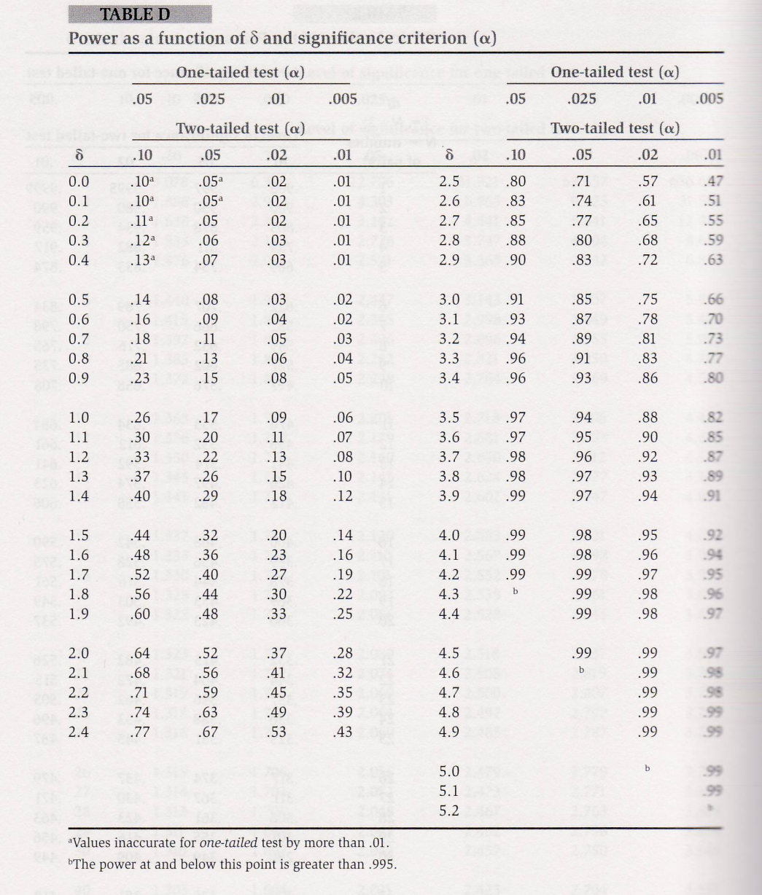
δ = d x f (N)
δ = d N ^{1/2}
d = 4/16 = .25
N = 16
δ = 1.0
What would it take for power = .80?
N = (δ / d )²
N = (2.8 / .25)² = 125.44

Slide 20
Power summary
Power reflects our ability to correctly reject the null hypothesis when it is false
Must have a specific alternative hypothesis in mind
  Alternatively, we can specify a target power level and, with a particular sample size determine how big of an effect we will be able to detect
We have higher power with larger samples and when testing for large effect sizes
There is a tradeoff between α and power

Slide 21
Questions?

